Slide 1
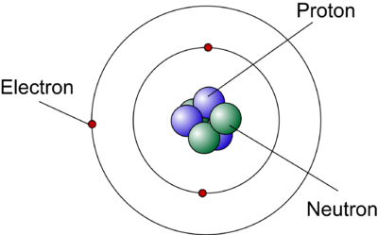
Ch 7 Notes Atomic Structure
AP Chemistry

Slide 2
The Electromagnetic Spectrum

Slide 3
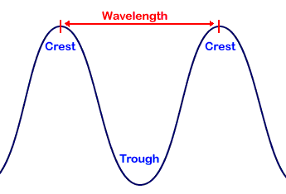
Wavelength and Frequency
The wavelength of a wave is the distance between successive peaks or troughs on the wave. It is measured in units of meters.
The frequency of a wave is a count of how many waves pass through a given point in one second. It is measured in units of Hertz.

Slide 4
The Speed of Light
All electromagnetic radiation travels at the same speed (the speed of light).
The speed of light is equal to 3.00 x 10⁸ m/s.
This is the same as 186,000 miles per second!
THE LARGER THE WAVELENGTH THE SMALLER THE FREQUENCY

Slide 5
c = λν
c = speed of light = 3.00 x 10⁸ m/s
= “lambda” = wavelength (units of meters)
ν = “nu” = frequency (units of Hertz (s⁻¹))

Slide 6
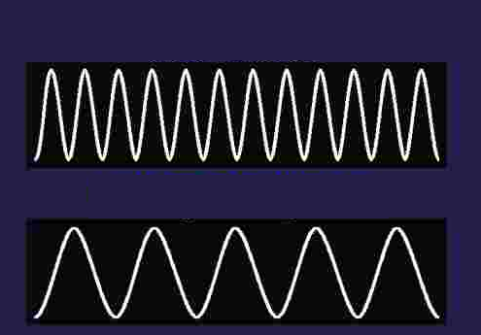
Energy of Electromagnetic Radiation
The longer the wavelength of the wave, the lower its frequency and the lower its energy.
E = hν E = energy (Joules)
h = Planck’s constant = 6.63 x 10⁻³⁴ Js
ν = frequency (Hertz)
Shorter wavelength = higher energy
Longer wavelength = lower energy

Slide 7
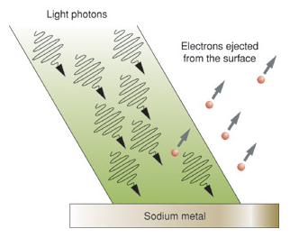
The Photoelectric Effect
The photoelectric effect is when light strikes the surface of a metal, electrons are emitted.
For this to be observed, light must strike with a minimum frequency (energy) called the threshold frequency.
Resulted in the concept of “quanta” small discreet quantities of energy can be absorbed or released by atoms.
Particles of light are called photons.

Slide 8
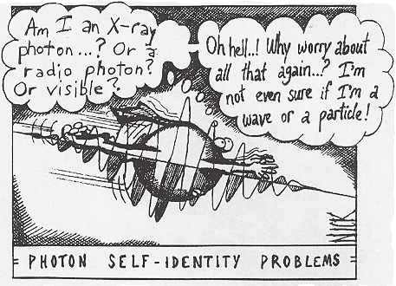
Duality of Light
Light exhibits both wave and particle properties
Does all matter exhibit wave properties?
Louis DeBroglie says YES.

Slide 9
DeBroglie Equation
Derivation:
Eqn 1 c=λν
Eqn 2 E = mc²
Eqn 3 E = hν
Combining eqn 1 and 3:
Combining the eqn above and Eqn 2
If the mass is big, the wavelength is small…
For any particle, substitute c for velocity v to get deBroglie’s equation

Slide 10
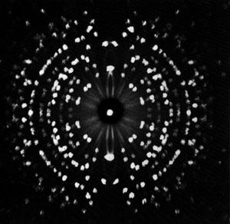
Electrons travel in waves
Diffraction occurs when light is scattered into a regular array of points.
A diffraction pattern can only be explained in terms of the constructive and destructive interference of waves
Electrons exhibit diffraction patterns!

Slide 11
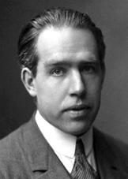
The Bohr Model of the Atom
Niels Bohr was a Danish physicist and a student of Rutherford. He wanted to determine the arrangement of electrons around the nucleus.
Bohr studied the light that could be absorbed or released by atoms.
He found that only specific wavelengths of light could be emitted by each different type of atom.

Slide 12
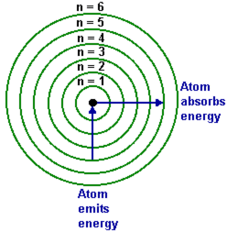
When an atom absorbs energy, it causes electrons to move further from the nucleus (excited state).
When those electrons fall back to a position closer to the nucleus (ground state), energy is emitted in the form of electromagnetic radiation.

Slide 13
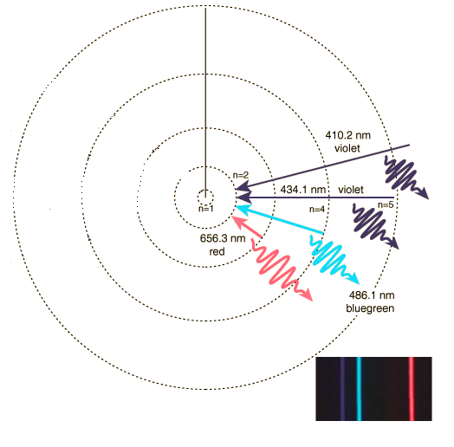
The wavelength of light released depends upon the distance the electron moved.
Because only particular wavelengths of light were released, Bohr determined that electrons can only be found at specific distances from the nucleus. He called these locations “energy levels”.

Slide 14
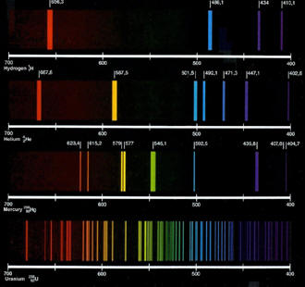
Atomic Emission Spectrum
An atomic emission spectrum shows the colors of light that a particular element can released when its electrons are excited.
Each element has its own unique spectrum.
Hydrogen
Helium
Mercury
Uranium

Slide 15
Calculating energy transitions in the Hydrogen atom
To calculate the energy of an electron in energy level “n”
To calculate the energy absorbed or released by the atom
ΔE = energy of the photon
If ΔE is negative, energy was released by the atom. If ΔE is positive, energy is absorbed by the atom.

Slide 16
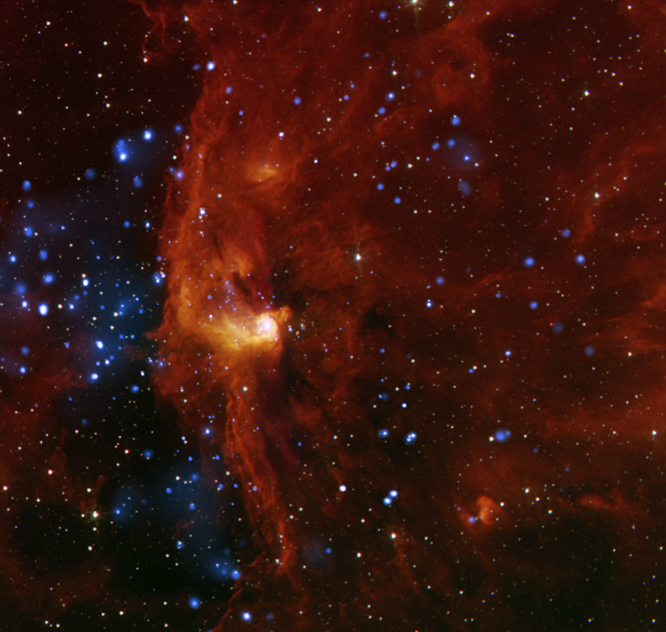
Uses of Atomic Emission Spectra
Chemists and physicists use atomic emission spectra to study the composition of unknown substances.
It is also used in astronomy and remote sensing to determine the composition of stars.

